Slide 1
EMRRG: Efficient Fine-Tuning Pre-trained X-ray Mamba Networks for Radiology Report Generation
Mingzheng Zhang, Jinfeng Gao, Dan Xu, Jiangrui Yu
Yuhan Qiao, Lan Chen, Jin Tang, Xiao Wang
讲者： 徐丹
指导老师：王逍
日期：2025.11.30

Slide 2



Introduction to X-ray Medical Report Generation
What is Radiology Report Generation?
An AI task that automatically translates medical images into coherent, structured textual reports
It bridges Computer Vision and Natural Language Processing, mimicking the workflow of a radiologist
Core Process: Image → Visual Features → Textual Description
Task Introduction
Automatically generate diagnostic reports from radiographs using AI
Goal: Assist clinicians by creating preliminary, descriptive text reports

Slide 3
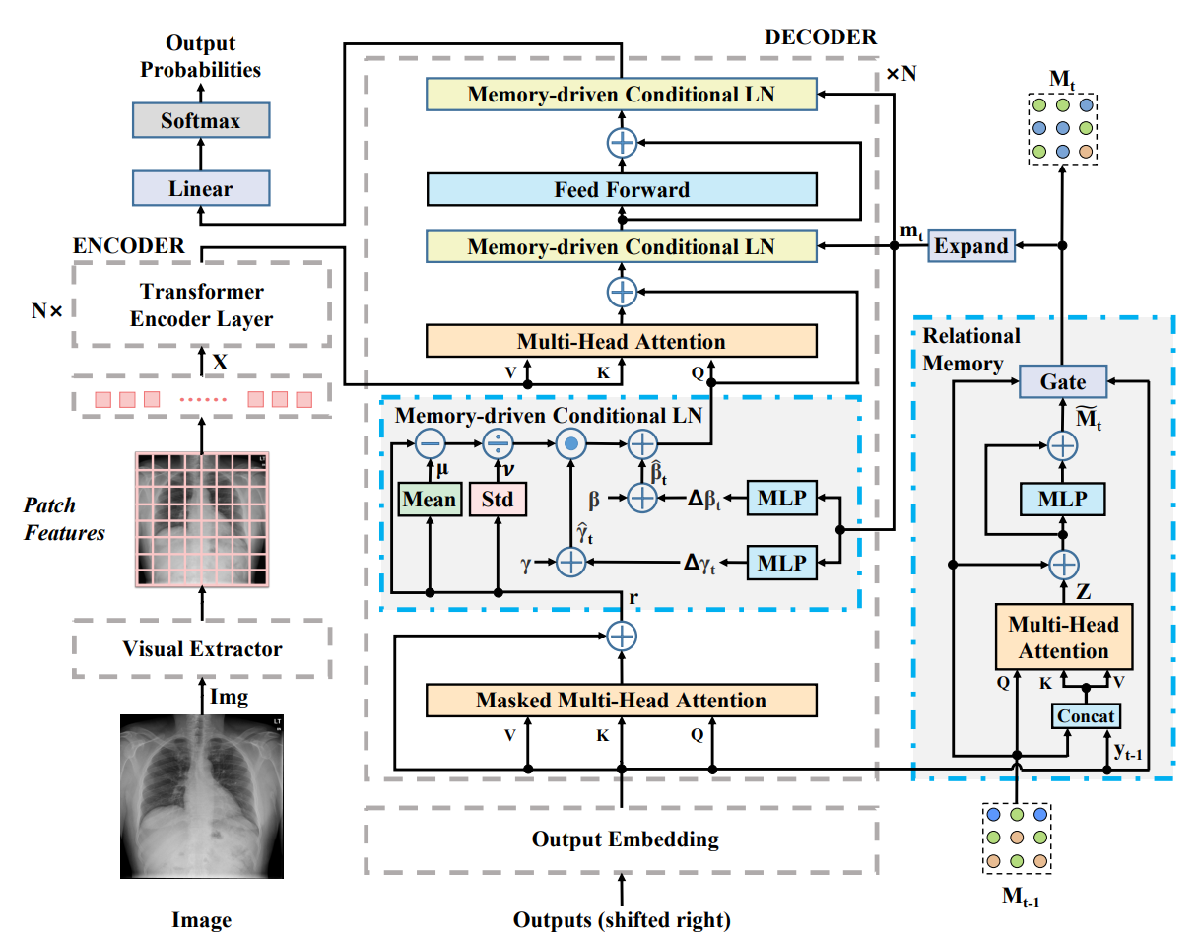
Existing Work: R2Gen
Core Idea
Uses a Relational Memory (RM) to capture recurrent patterns in reports.
Integrates memory into the Transformer decoder via Memory-driven Conditional Layer Normalization (MCLN).
Key Contributions
Achieved state-of-the-art (SOTA) performance on IU X-Ray and MIMIC-CXR.
First work to comprehensively benchmark report generation on the MIMIC-CXR dataset.

Slide 4
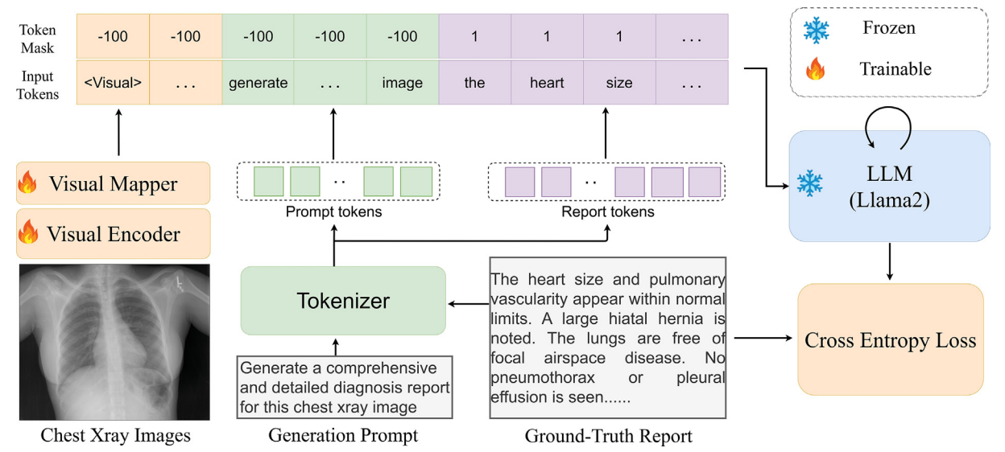
Existing Work: R2GenGPT
Core Idea
Align & Freeze: Maps visual features into a frozen LLM's (Llama2) embedding space.
Parameter-Efficient: Explores 3 tuning strategies with minimal trainable parameters.
Key Contributions
Pioneering Use of LLM: First to leverage frozen LLMs for radiology report generation.
Rigid LLM: High Efficiency: Achieves strong performance by training only 0.07% parameters.
SOTA Performance: Reaches or surpasses state-of-the-art on IU X-Ray and MIMIC-CXR.

Slide 5
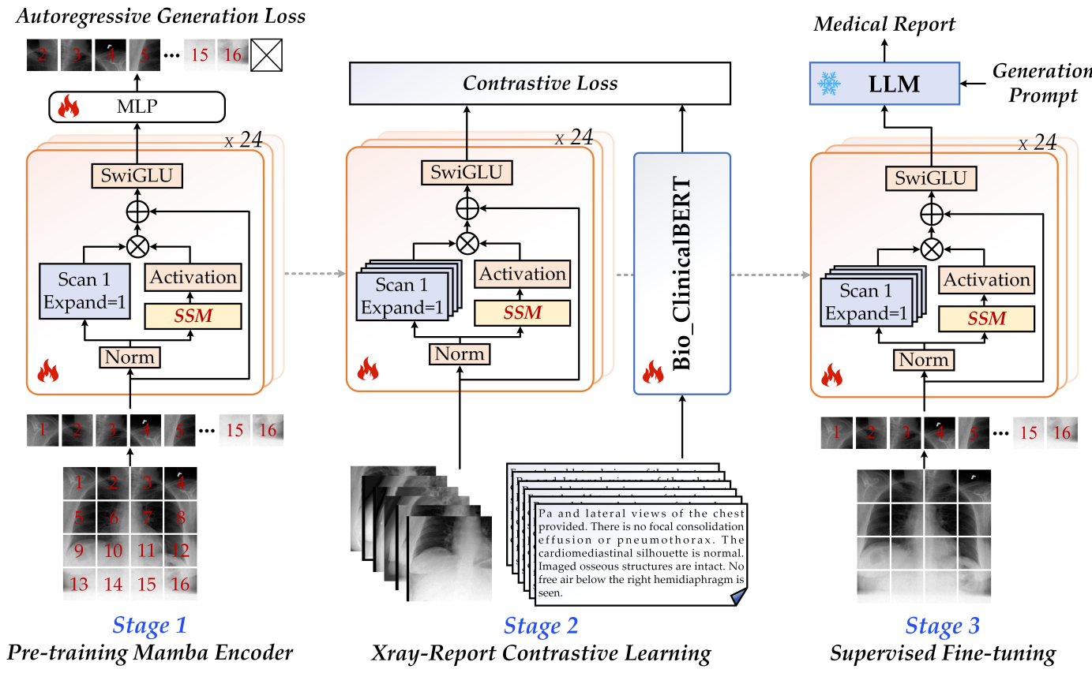
Existing Work: MambaXray-VL: Pre-training for X-ray
Report Generation
Core Idea
Multi-stage pre-training: autoregressive + contrastive + fine-tuning
Mamba vision encoder with O(N) complexity
Replaces traditional Transformer-based encoders
Key Contributions
Built CXPMRG-Bench - first large benchmark on CheXpert Plus
Achieves SOTA across multiple datasets
ARG pre-training outperforms MAE on X-rays
Evaluates 35+ models (19 MRG + 16 LLMs/VLMs)

Slide 6
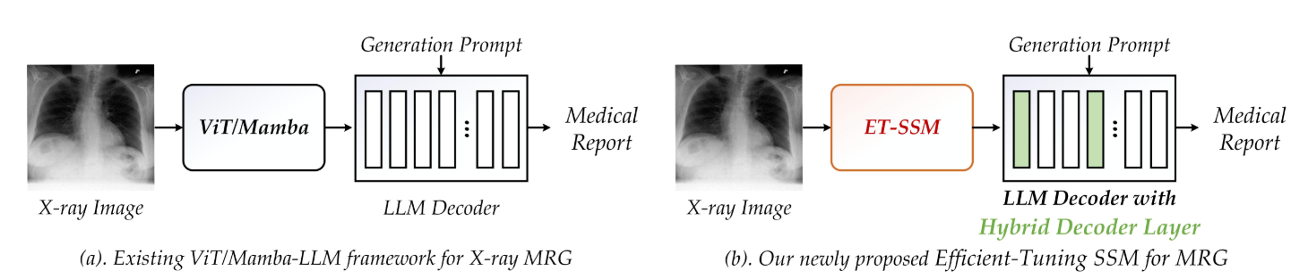

Limitations of Current Approaches and Our Contributions
Existing MRG systems face critical limitations that our EMRRG framework addresses through novel architectural innovations and efficient tuning strategies
Key Limitations of Current Methods
Our EMRRG Framework Contributions
• Insufficient exploration of pre-trained vision models with lightweight fine-tuning
• Limited cross-attention capabilities in LLM-based generation frameworks
• Underutilization of non-Transformer architectures like Mamba networks
• Novel Mamba-based architecture with parameter-efficient fine-tuning strategy
• Hybrid decoder layer augmented LLM for enhanced cross-attention
• Strong performance across IU X-ray, MIMIC-CXR, and CheXpert Plus datasets

Slide 7
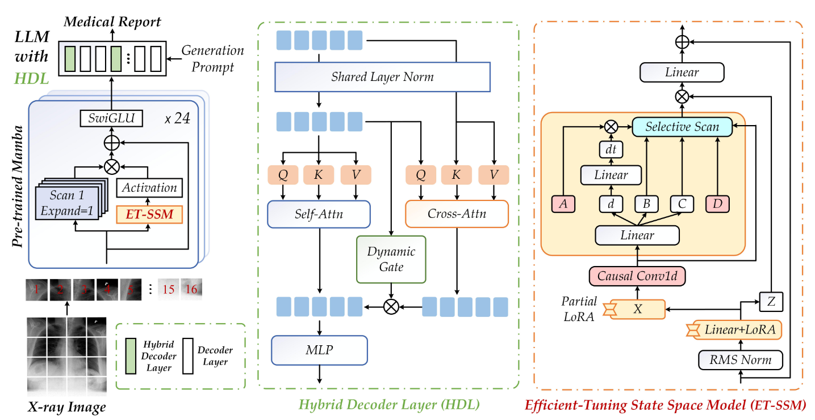

Overview of EMRRG Framework
Framework Components
• Combines efficient-tuning Mamba networks with hybrid decoder-augmented LLMs
• Utilizes ET-SSM (Efficient-Tuning based SSM) for visual feature extraction
• Incorporates hybrid decoder layers in LLM for cross-modal integration

Slide 8

Overview of EMRRG Framework
Key Innovations
• Partial LoRA (LoRA_{P}(X)) selectively adapts Mamba intermediate features
• Cross-attention mechanism enables dynamic visual-textual information fusion
• Dynamic gating modulates information flow between modalities

Slide 9
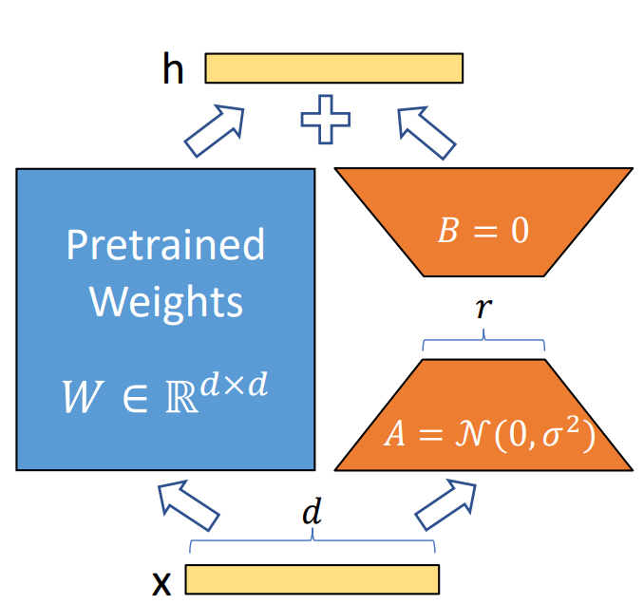
Efficient-Tuning SSM (ET-SSM)
Partial LoRA (LoRA_{P}(X)):
Applies LoRA only to intermediate feature X in Mamba blocks
Preserves other features (Z, dt, B, C) to maintain model stability
Traditional LoRA:
Fine-tunes input projection layer for better source representation
Advantage:
Combines targeted adaptation with global optimization, improving training efficiency without sacrificing capacity
Traditional LoRA

Slide 10
Hybrid Decoder Layer Design
Architecture:
Parallel Self-Attention (text-text) and Cross-Attention (text-visual)
Skip connections for training stability
Dynamic Gating Mechanism:
Token-wise gating values via linear layer + tanh
Warm-up initialization for stable training
Adaptive fusion of visual features into text embeddings

Slide 11



Experimental Setup and Datasets
Overview of datasets, evaluation metrics, and implementation details for EMRRG validation
Datasets
Evaluation Metrics
Implementation Details
• Three public benchmarks: IU-Xray, MIMIC-CXR, and CheXpert Plus
• Standard datasets for evaluating medical report generation performance
• Natural Language Metrics: BLEU, ROUGE-L, METEOR, CIDEr
• Clinical Metrics: Precision, Recall, and F1-measure
• IU-Xray: 30 epochs, batch size 20, Qwen-1.5-1.8B LLM
• MIMIC-CXR/CheXpert Plus: 6 epochs, batch size 18, Llama2-7B LLM
• LoRA_{P}(X) fine-tuning with rank=32 on in_proj layer weights

Slide 12

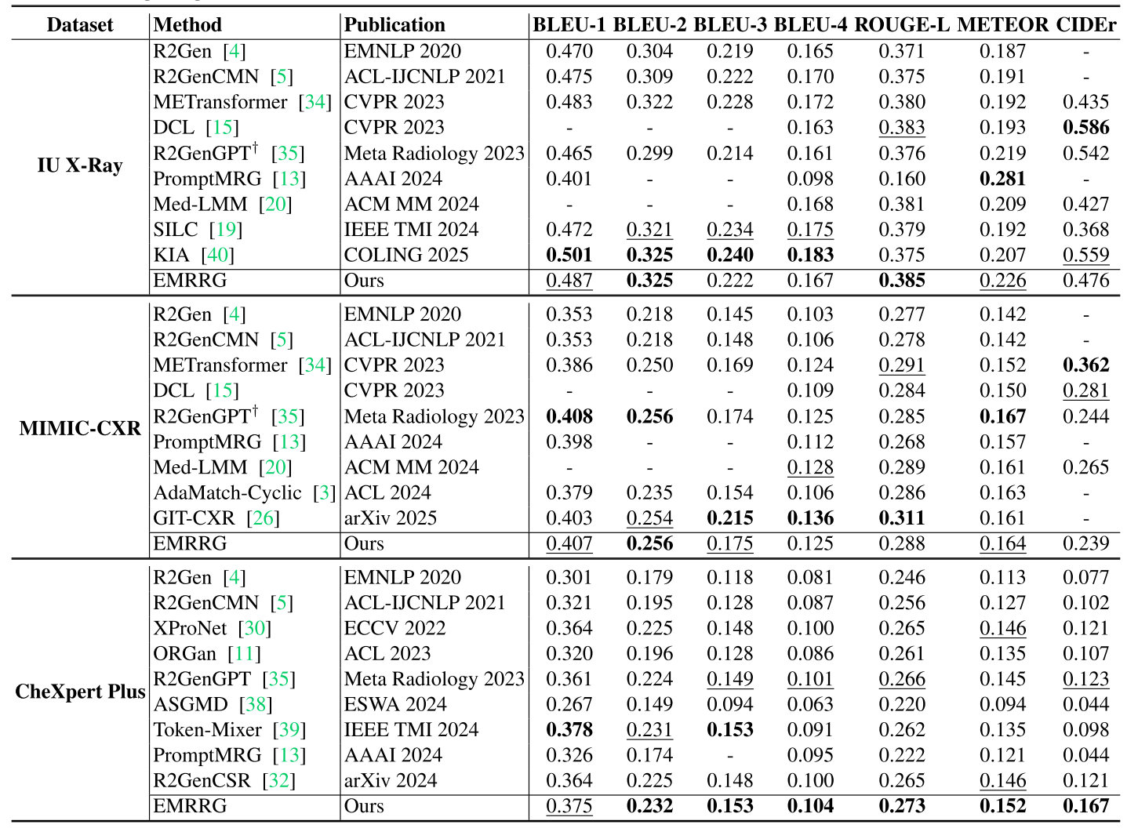

Performance Comparison on Public Benchmarks
IU X-ray Results
• Achieved SOTA performance on BLEU-2 (0.325) and ROUGE-L (0.385)
• Second-best on BLEU-1 (0.487) and METEOR (0.226) metrics
• Performance comparable to other SOTA report generation approaches
MIMIC-CXR & CheXpert Plus Results
• Strong performance on MIMIC-CXR with 0.311 ROUGE-L and 0.239 CIDEr
• CheXpert Plus SOTA results: BLEU-4 (0.104), ROUGE-L (0.273), METEOR (0.152)
• Consistent performance across all three benchmark datasets
NLG Metrics Comparison

Slide 13
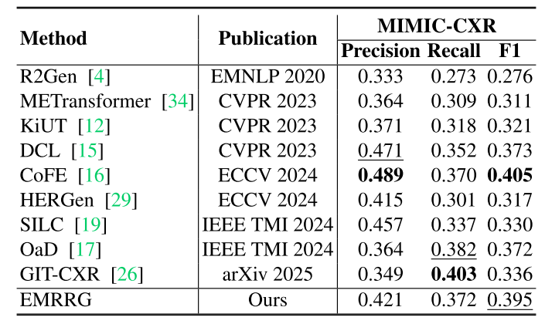

Clinical Evaluation Metrics Results
MIMIC-CXR Clinical Metrics
• Precision: 0.421, Recall: 0.372, F1-score: 0.395
• Performance comparable to state-of-the-art clinical evaluation results
• Balanced performance between precision and recall metrics
Clinical Metrics Comparison

Slide 14
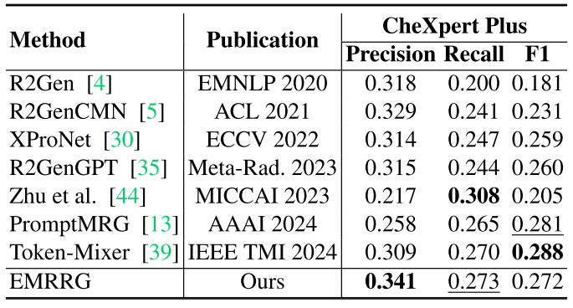

Clinical Evaluation Metrics Results
CheXpert Plus Clinical Metrics
• Precision: 0.341, Recall: 0.273, F1-score: 0.272
• Consistent clinical relevance across different datasets
• Demonstrates EMRRG's ability to capture clinically meaningful findings
Clinical Metrics Comparison

Slide 15
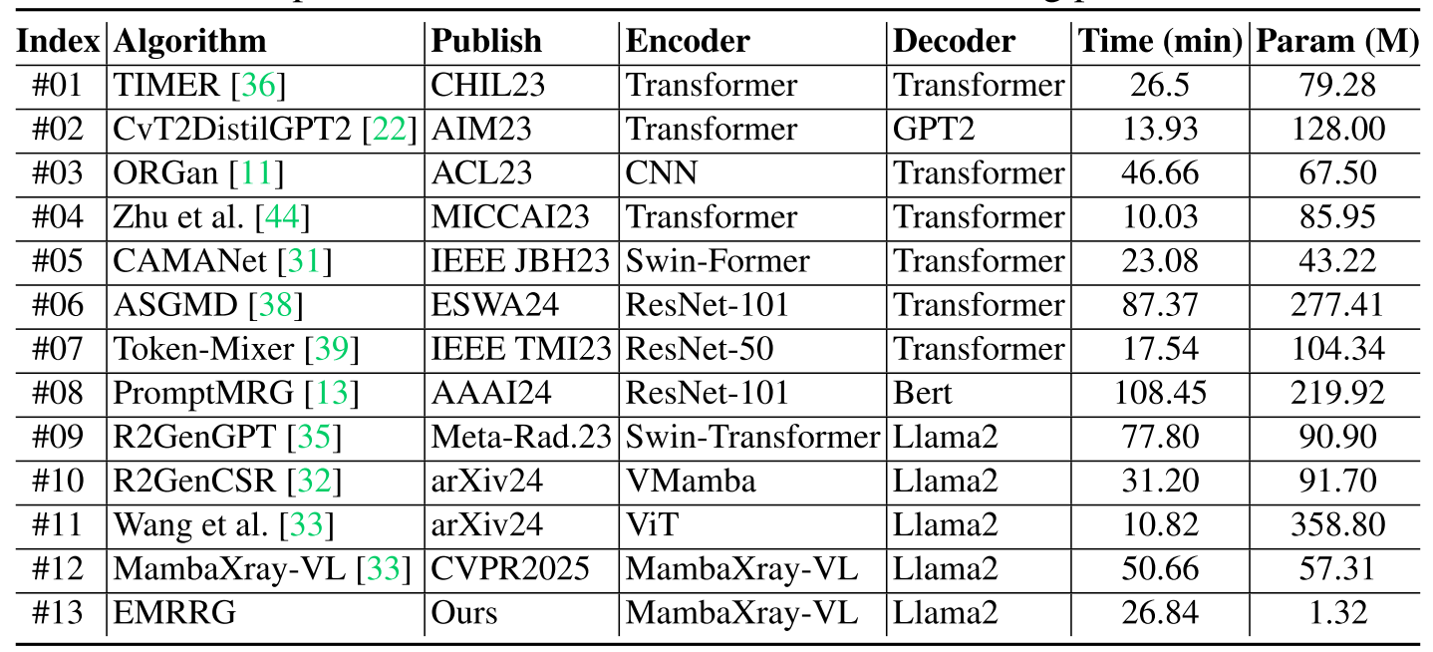


Runtime Efficiency Analysis
Runtime Efficiency Comparison
Computational Efficiency
Efficiency Advantages
• Training time: 26.84 minutes on CheXpert Plus dataset
• Only 1.32M parameters required for fine-tuning
• Significantly faster than PromptMRG (108.45 min) and ASGMD (87.37 min)
• 2.3% of parameters compared to full fine-tuning methods
• Maintains performance close to full parameter fine-tuning
• MambaXray-VL encoder + Llama2 decoder architecture optimizes speed

Slide 16
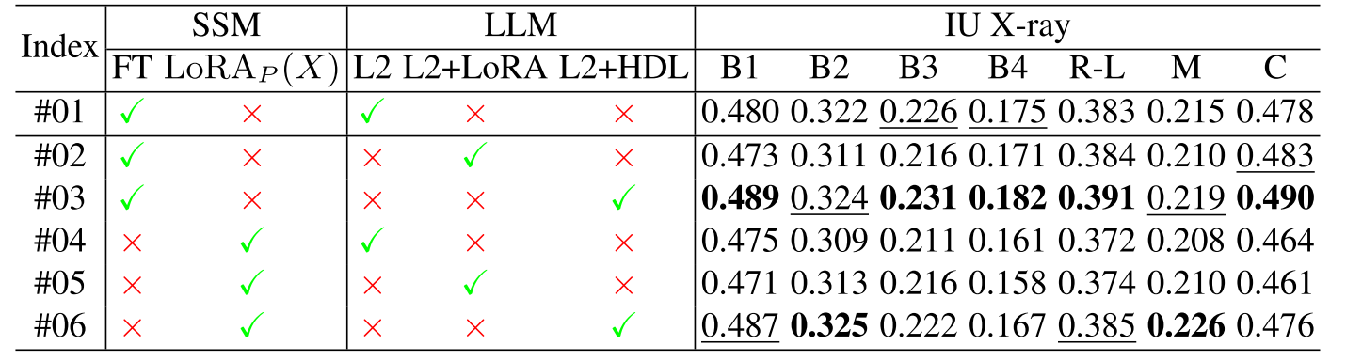


Ablation Study and Component Analysis
Component Analysis Results
Component Analysis
Parameter Efficiency
• LoRA_{P}(X) method achieves performance close to full fine-tuning
• Llama2+HDL outperforms standard Llama2 and Llama2+LoRA
• Combination of FT + Llama2+HDL achieves optimal results on most metrics
• EMRRG requires 2.3% of parameters compared to full fine-tuning
• Maintains performance while significantly improving training efficiency
• LoRA_{P}(X)+Llama2+HDL achieves optimal BLEU-2 and METEOR scores

Slide 17
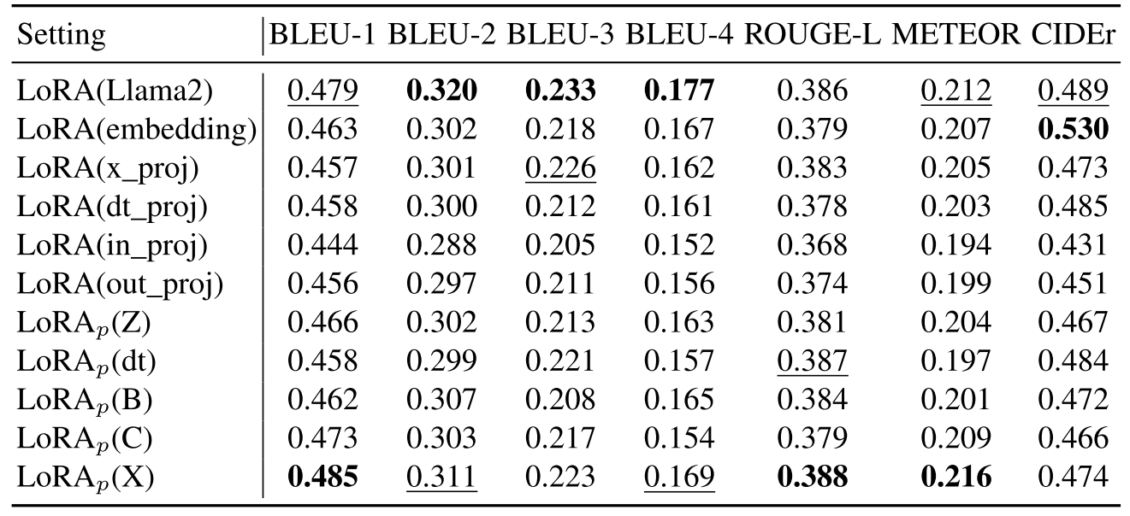
Ablation Study – Tuning Strategies
Ablation on Fine-tuning Strategies
LoRA_{P}(X)Achieves Best Overall Performance:
BLEU-1: 0.485, ROUGE-L: 0.388
Outperforms LoRA_{P}(Z), LoRA_{P}(dt), LoRA_{P}(B), LoRA_{P}(C)
Interpretation: Fine-tuning feature X most effectively adapts visual representations for report generation.

Slide 18
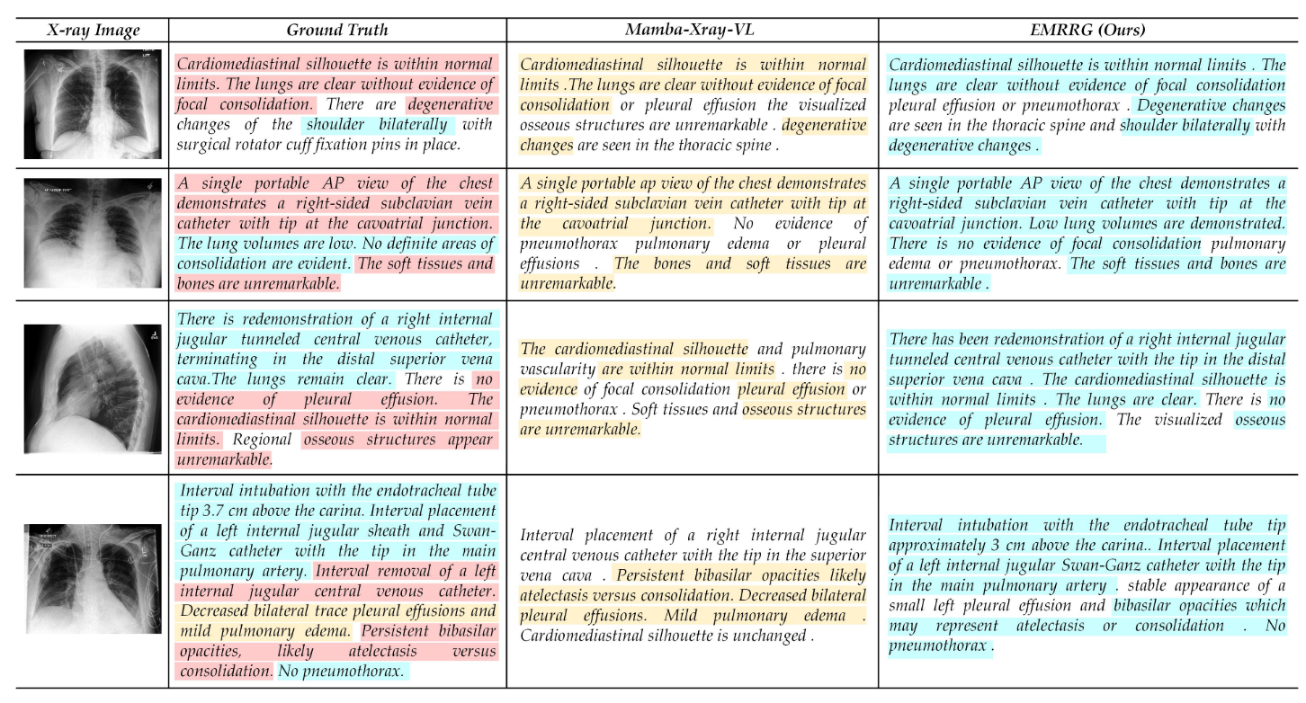
Qualitative Results & Visualization
Case Studies: Compare Ground Truth, MambaXray-VL, and EMRRG reports
Highlights: Yellow: MambaXray-VL matches；Cyan: EMRRG matches；Pink: Both match
Observation: EMRRG generates more accurate and detailed descriptions of pathologies.

Slide 19



Conclusion and Future Work
This section summarizes EMRRG's contributions and outlines potential research directions for X-ray medical report generation.
Key Contributions
Experimental Validation
Future Research Directions
• Proposed EMRRG architecture for efficient X-ray medical report generation
• Developed LoRA_{P}(X) method for parameter-efficient Mamba structure fine-tuning
• Introduced Hybrid Decoder Layers to replace conventional decoder layers in LLMs
• Achieved SOTA performance on IU X-ray, MIMIC-CXR, and CheXpert Plus datasets
• Demonstrated 0.325 BLEU-2 and 0.385 ROUGE-L scores on IU X-ray dataset
• Validated efficiency with only 2.3% parameter training compared to full fine-tuning
• Improve generalization across diverse NLG metrics like CIDEr score
• Enhance clinical accuracy for rare disease descriptions
• Optimize hybrid decoder layer distribution for better performance

Slide 20
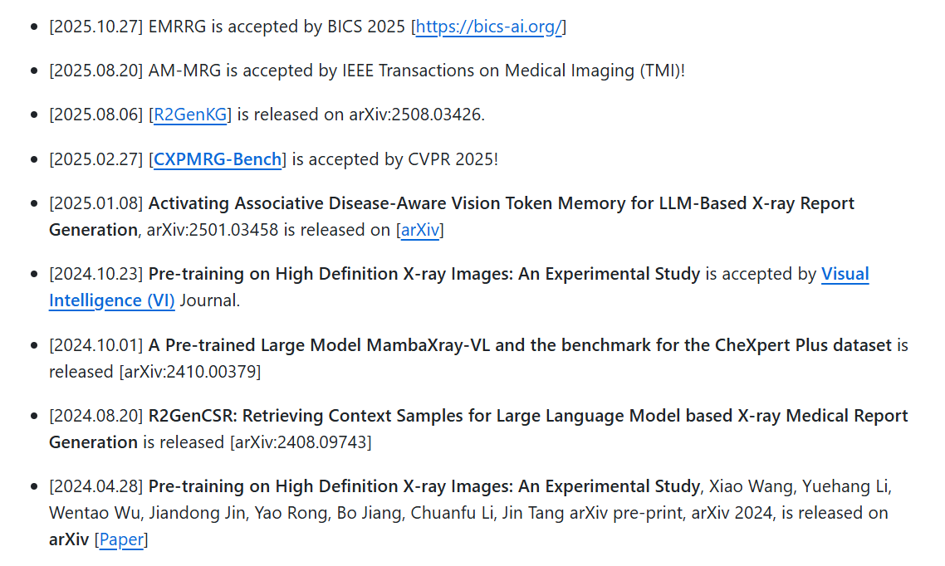
Code Availability & Contributions
Open-Source Code: https://github.com/Event-AHU/Medical_Image_Analysis
Our Related Projects:

Slide 21



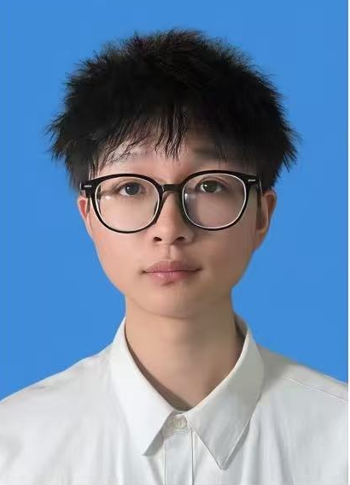




About the Authors
汤进
王逍
陈岚
张明政
高金锋
余江睿
乔雨晗
徐丹

Slide 22
Thank You！

